Slide 1


CS-429 Introduction to Data Science
Instructor: Mubahir Iqbal

Slide 2
Unsupervised Machine Learning
K-means Clustering Algorithm

Slide 3
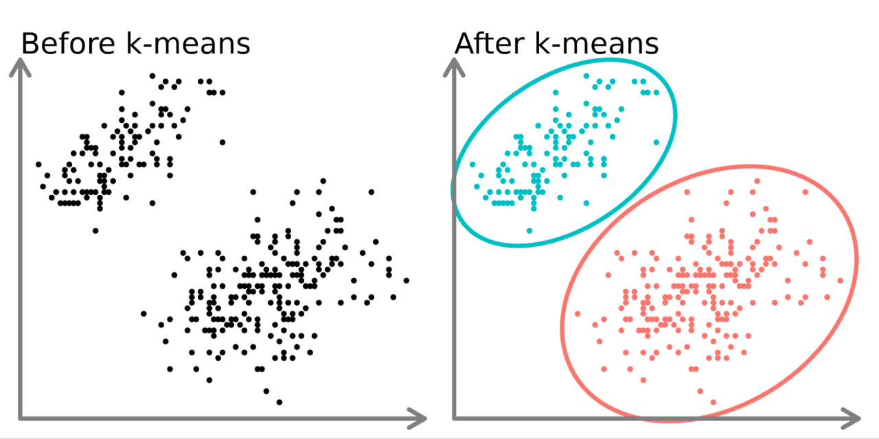
K-mean Clustering
A type of unsupervised machine learning that groups data into clusters based on similarity.
This is the popular clustering algorithm that partitions data into K clusters.

Slide 4
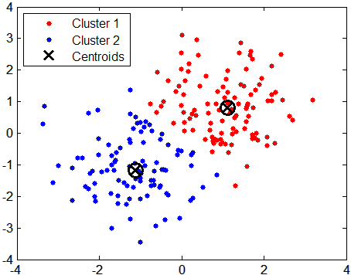
K-mean Clustering
Key Concepts
Centroids: Each cluster is represented by a centroid (mean of the points in the cluster).
K: The number of clusters, which is chosen before applying the algorithm

Slide 5
Steps
Initialization: Choose the number of clusters, and the value of K.
Assignment Step: Assign each data point to the nearest centroid using the Euclidean distance formula
Update Step: Recalculate the centroids as the mean of all data points assigned to that cluster.
Repeat: Repeat the assignment and update steps until the centroids no longer change (convergence).
Output: Final cluster assignments and centroids.

Slide 6
Applications of K-Means
Image compression.
Customer segmentation in marketing.
Anomaly detection.
Document clustering in NLP.

Slide 7

limitations and challenges in K-Means
Selection of the Number of Clusters (k)Customer segmentation in marketing. where n is the number of data points.
As the number of features or data points increases, algorithms become computationally expensive.
Convergence issues: the solution can fail to exist, if the algorithm falls into a loop, For example, keeps going back and forth between two possible solutions, or in other words, there isn’t a single unique solution.
$$1≤k≤n$$

Slide 8
Example 1
Consider following eight points.
Take P1, P2, and P7 as initial centroids.
P1 (2, 2)
P2 (1, 14)
P3 (10, 7)
P4 (1, 11)
P5 (3, 4)
P6 (11, 8)
P7 (4, 3)
P8 (12, 9)

Slide 9
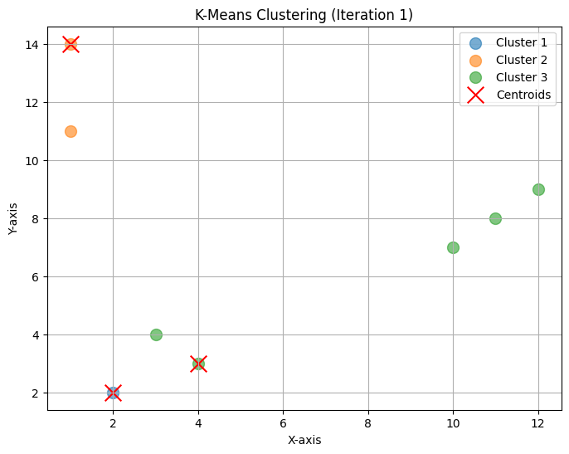
Example 1
First plot with initial centroids points

Slide 10
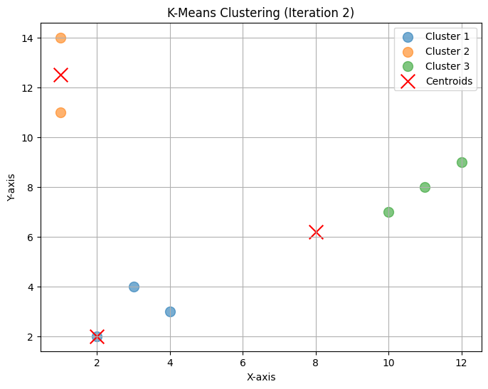
Example 1
2nd Iteration

Slide 11
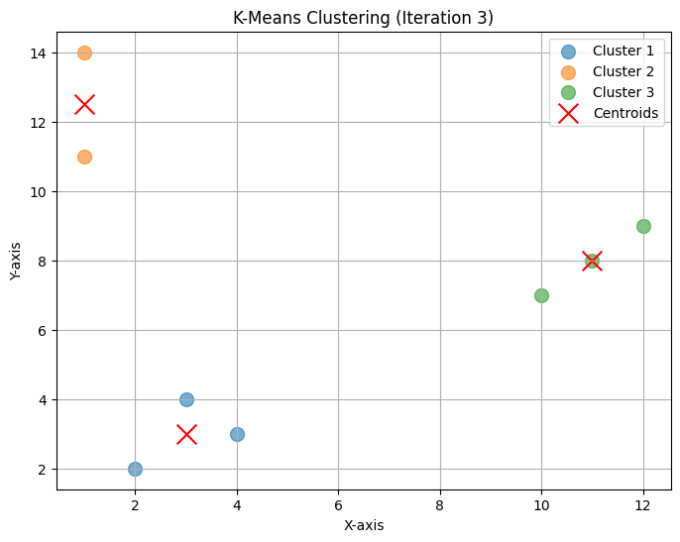
Example 1
3rd Iteration

Slide 12
Example 1 python Code
import numpy as np
import matplotlib.pyplot as plt
import os
points = np.array([ [2, 2], [1, 14], [10, 7], [1, 11], [3, 4], [11, 8], [4, 3], [12, 9], ])
point_names = ["P1", "P2", "P3", "P4", "P5", "P6", "P7", "P8"]
# Initial centroids: P1, P2, and P7
initial_centroids = np.array([ [2, 2], [1, 14], [4, 3], ])
# Number of iterations to compute
iterations = 20
# Initialize centroids
centroids = initial_centroids
# Perform clustering iterations
for iteration in range(iterations):
distances = np.linalg.norm(points[:, np.newaxis] - centroids, axis=2) # Euclidean distances
labels = np.argmin(distances, axis=1) # Assign to nearest cluster
new_centroids = np.array([
points[labels == cluster].mean(axis=0) if np.any(labels == cluster) else centroids[cluster]
for cluster in range(len(centroids))
])
plt.figure(figsize=(8, 6))
for cluster in range(len(centroids)):
cluster_points = points[labels == cluster]
plt.scatter(cluster_points[:, 0], cluster_points[:, 1], s=100, alpha=0.6, label=f'Cluster {cluster + 1}')
plt.scatter(centroids[:, 0], centroids[:, 1], c='red', marker='x', s=200, label='Centroids')
plt.title(f"K-Means Clustering (Iteration {iteration + 1})")
plt.xlabel("X-axis")
plt.ylabel("Y-axis")
plt.grid(True)
plt.legend()
plt.show()
plt.close()
# Check for convergence (if centroids do not change)
if np.allclose(centroids, new_centroids):
print(f"Centroids converged. Stopping early. {iteration}")
break
centroids = new_centroids # Update centroids for the next iteration

Slide 13
Datasets
Iris Dataset
Mall Customers Dataset
Digits Dataset
Customer Segmentation Dataset
Blobs Dataset (Synthetic Data)
Wholesale Customers Dataset
Cities Clustering Dataset

Slide 14
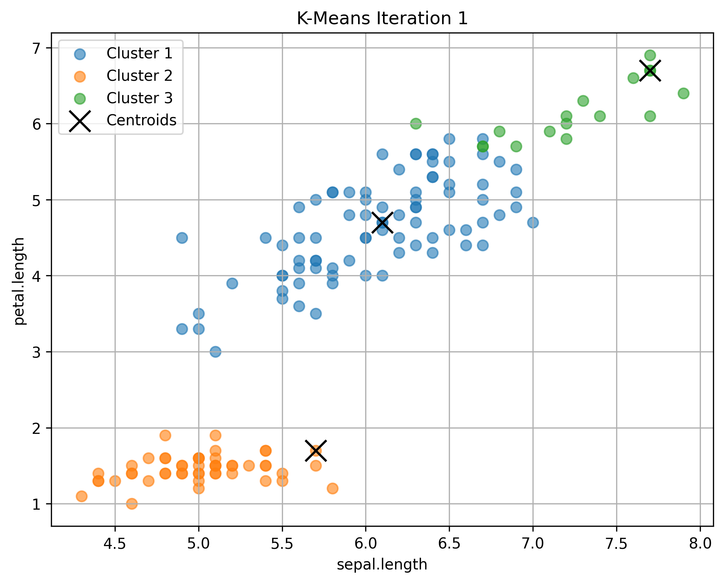
Example 2 : Iris Dataset
First plot with initial centroids points

Slide 15
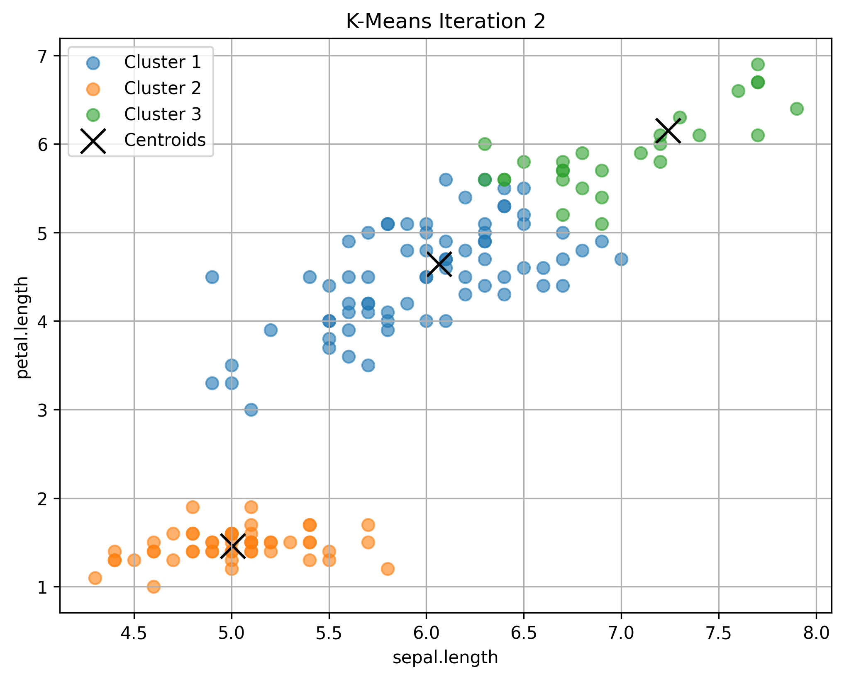
Example 2 : Iris Dataset

Slide 16

Example 2 : Iris Dataset

Slide 17

Example 2 : Iris Dataset

Slide 18
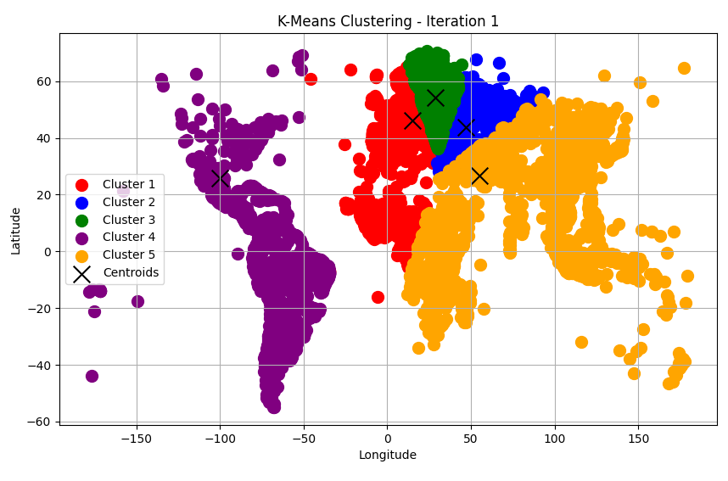
Example 3 : Cities Clustering Dataset
First plot with initial centroids points

Slide 19
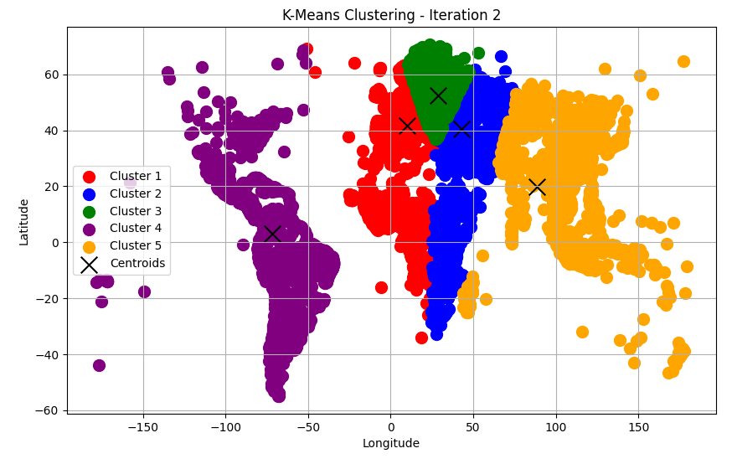
Example 3 : Cities Clustering Dataset

Slide 20
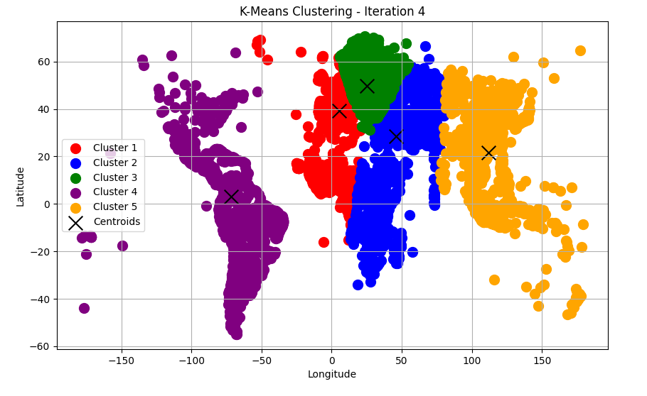
Example 3 : Cities Clustering Dataset

Slide 21
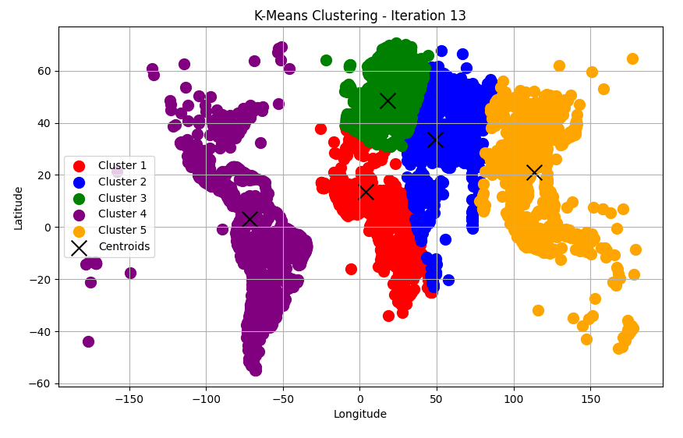
Example 3 : Cities Clustering Dataset

Slide 22
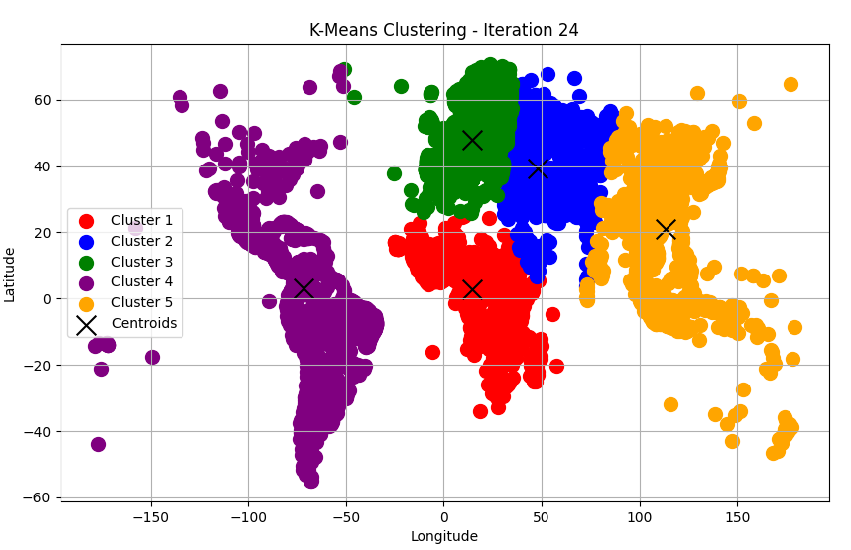
Example 3 : Cities Clustering Dataset

Slide 23


Slide 24
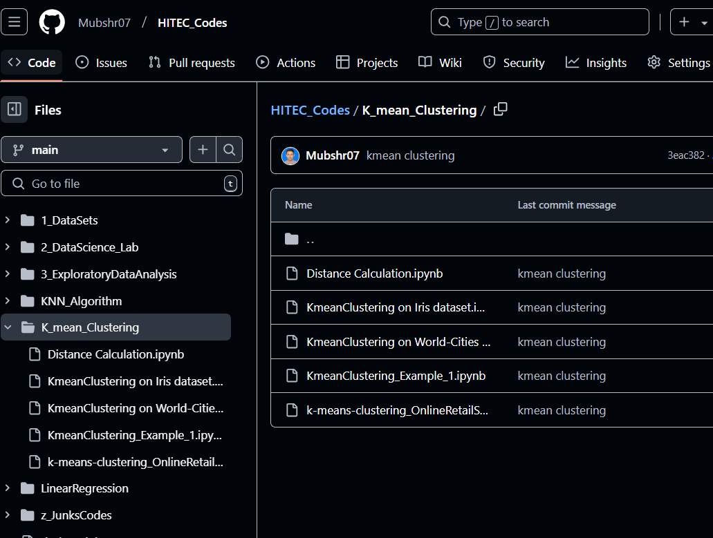
Python ipynb code
Link: Mubshr07/HITEC_Codes

Slide 25

Jannah: Home at Last, a Yaqeen Series with Dr. Omar Suleiman
URL: Ramadan 2023 | Jannah: Home at Last, a Yaqeen Series with Dr. Omar Suleiman | #Jannah #RamadanSeries
Number of episodes: 30
Total Duration: 05 ~ 06 Hrs

